Slide 1
Professional Certification Practical Exam Presentation

Slide 2
BUSINESS GOALS
Pens and Printers mission is to provide high quality office products for large organizations. They prioritize rolling over new products expeditiously to it’s clients before it’s competitors.
Due to the high expectations of their clients and their ever changing approach to purchasing new products, the sales team want to focus on the best sales method not only to increase productivity but also to increase their revenue. The sales team wants to identify the following using data on the previous launch:
Number of customers for each approach
Spread of revenue overall and for each sales method
Difference in revenue over time for each sales method
Difference in customers for each group
Recommendations

Slide 3
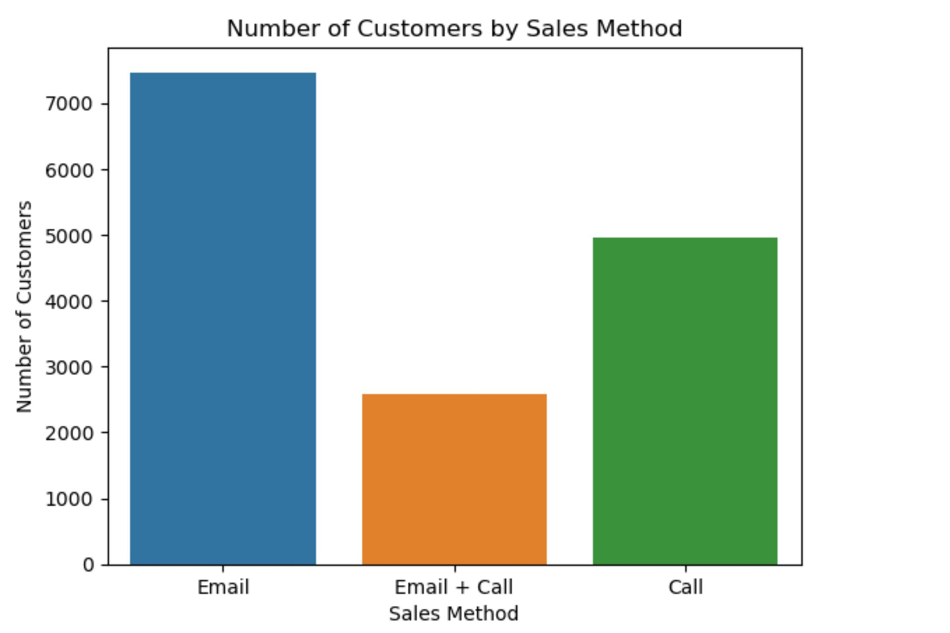
FINDINGS
Number of Customers per sales method
Based on the data from the last new product launch, the Email approach had the highest number of customers (7466) which makes up almost 50% of the total number of customers. It was followed by the Call approach (4962) which made up 33% of the total number of customers and the Email + Call approach (2572) with 17% of the total number of customers.
The next slide will identify if these numbers are directly proportional to the revenue each method generated

Slide 4
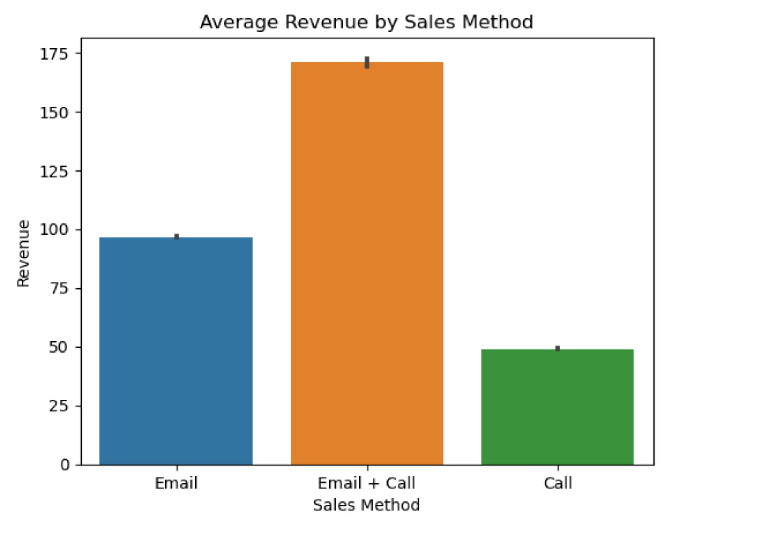
FINDINGS
Average Revenue by Sales Method
The Email + Call sales method had the highest average revenue (170.88) which is almost twice the average generated by the Email sales method (96.57) and almost four times that of the Call method (49.13) even though it had the least number of customers.
This shows that a lot more customers are likely to purchase a lot more or higher value products when the Email + Call sales method is used.

Slide 5
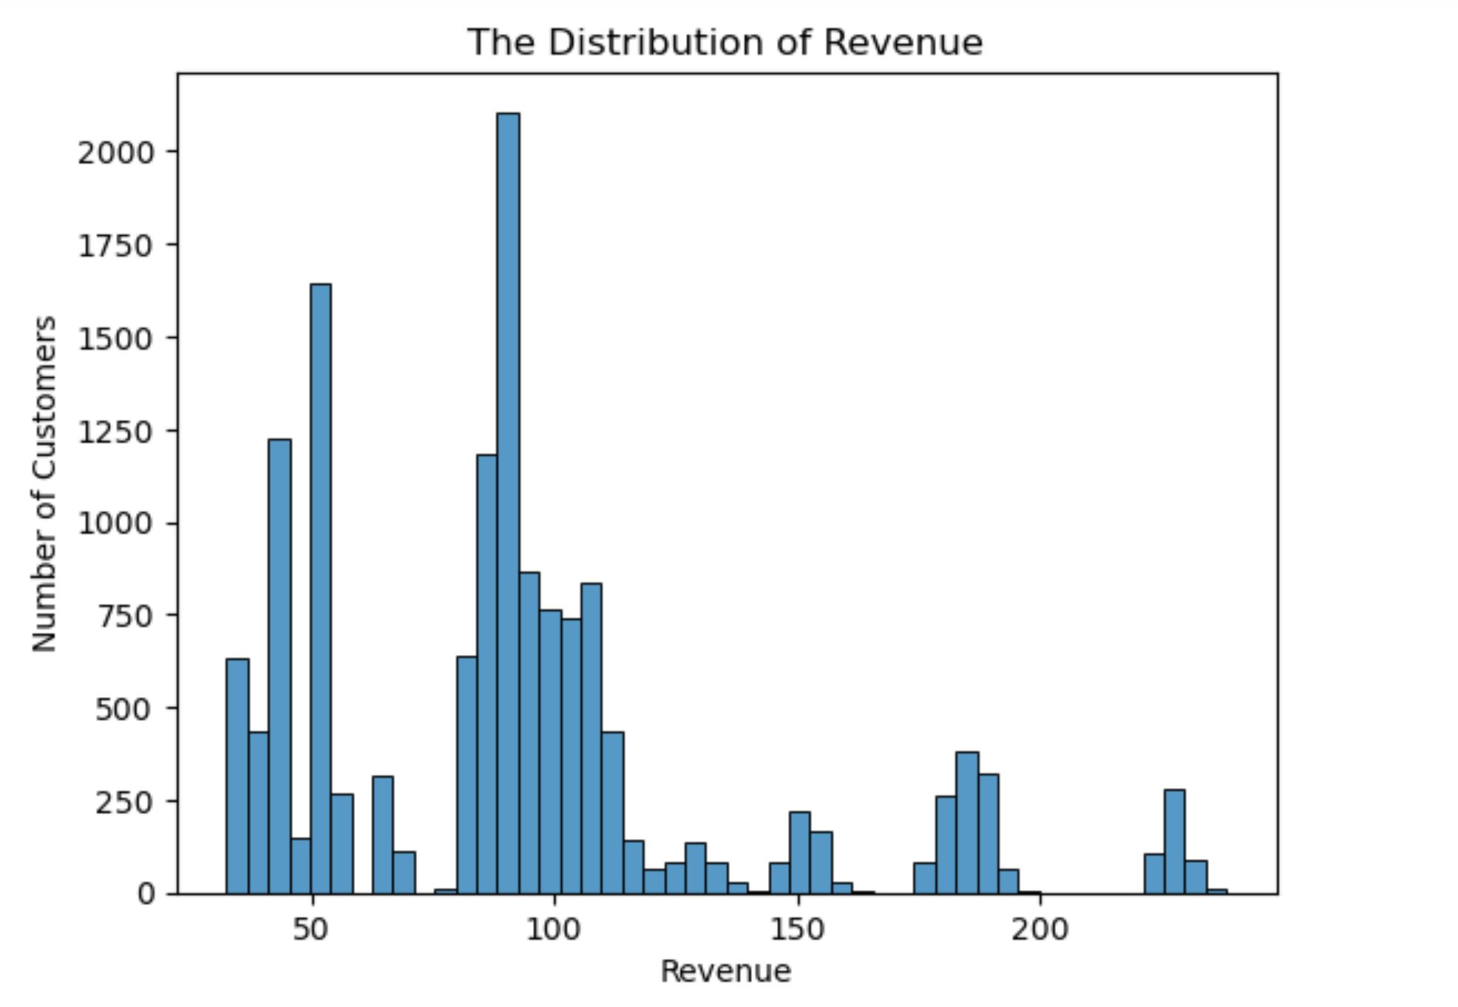
FINDINGS
Overall Spread of Revenue
From the histogram diagram we can see majority of the revenue generated by customers was 185.6 and below. Anything above this value could be considered an outlier.

Slide 6
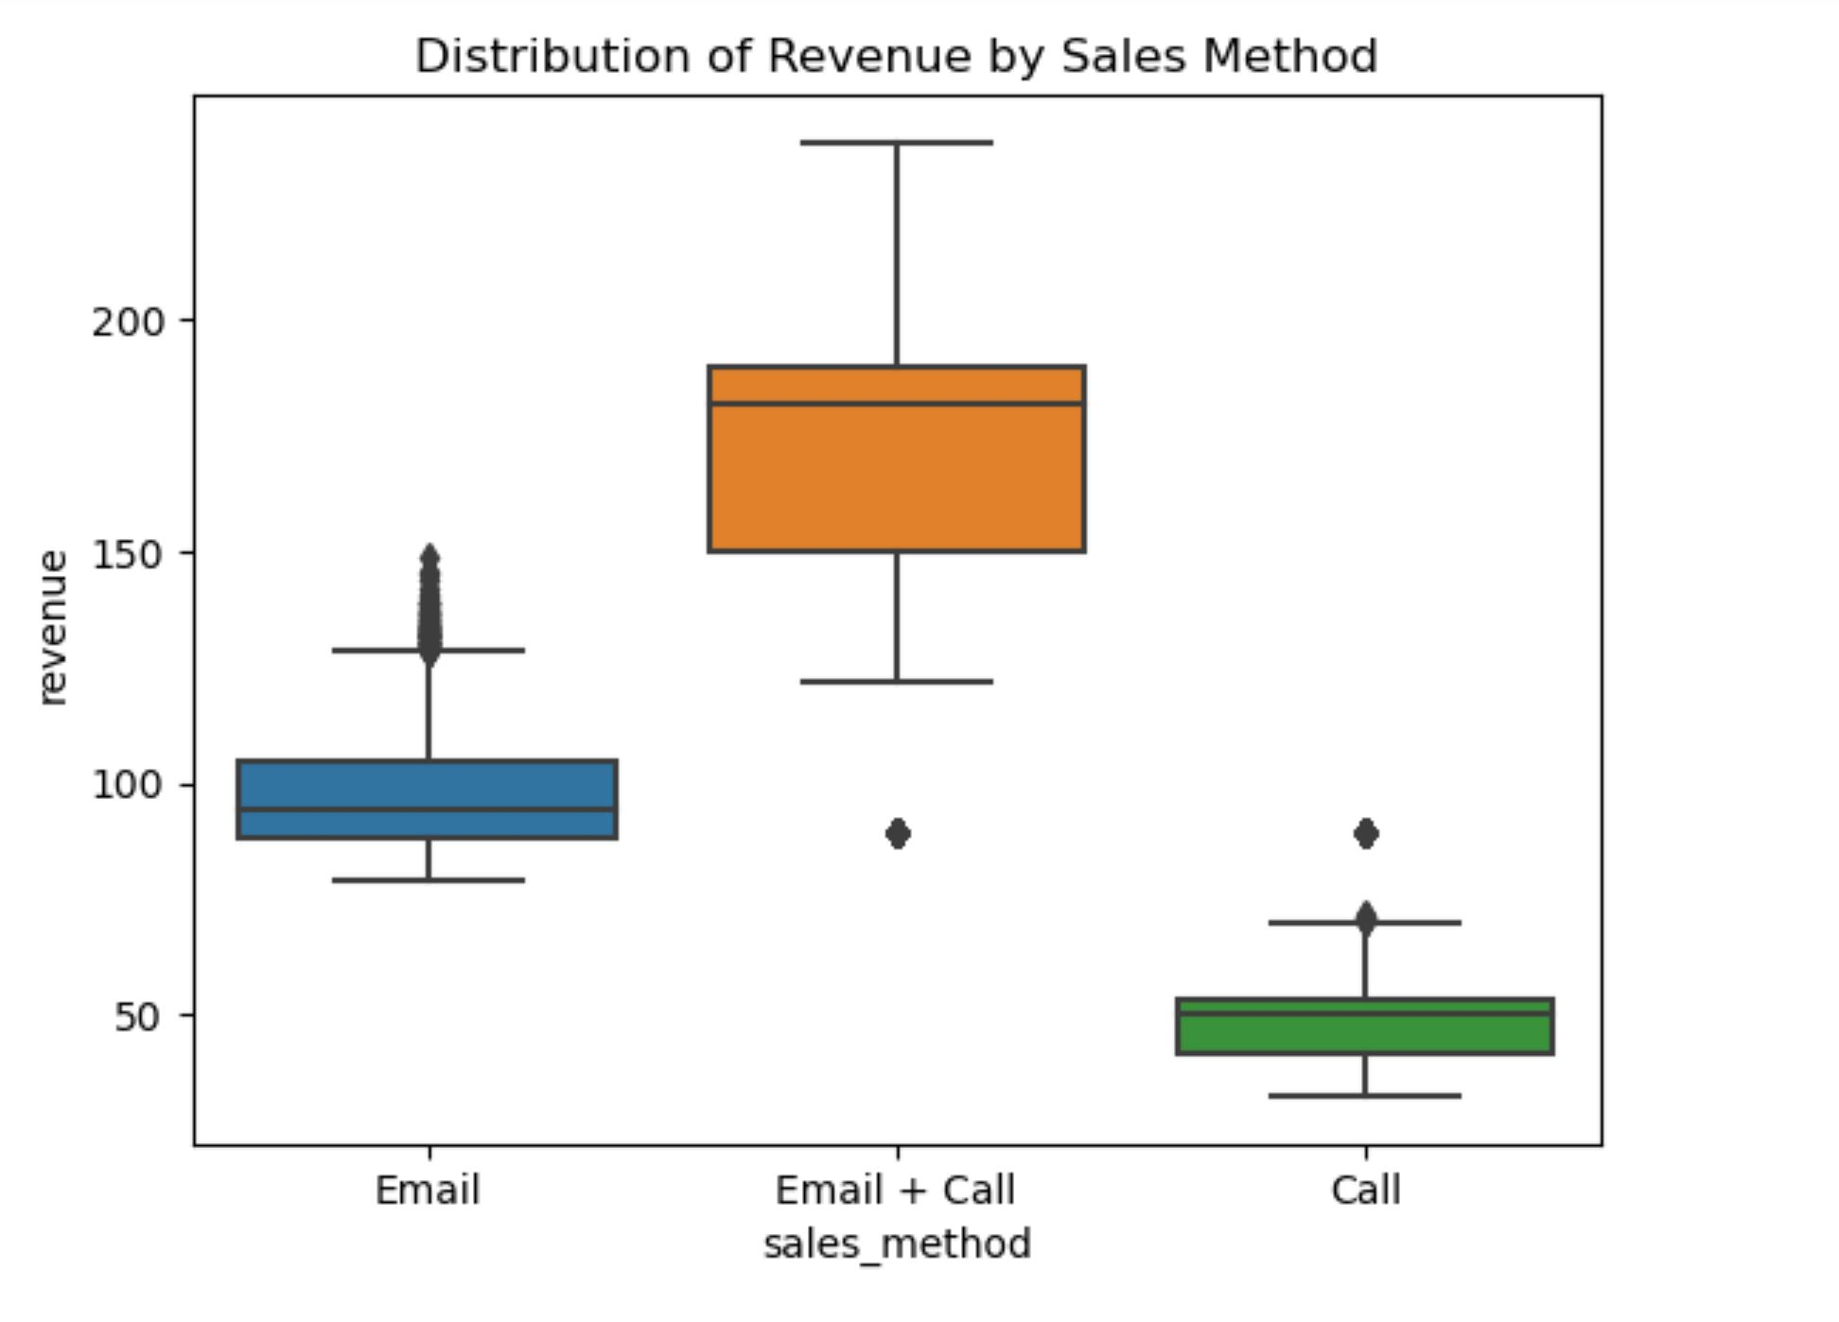
FINDINGS
Distribution of Revenue by Sales Method
From the boxplots we can see that the revenue generated by the customers from the Email + Call sales method is significantly higher than the others.
This again confirms that the Email + Call sales method has the potential to generate a lot more revenue if a lot of focus was placed on it.

Slide 7
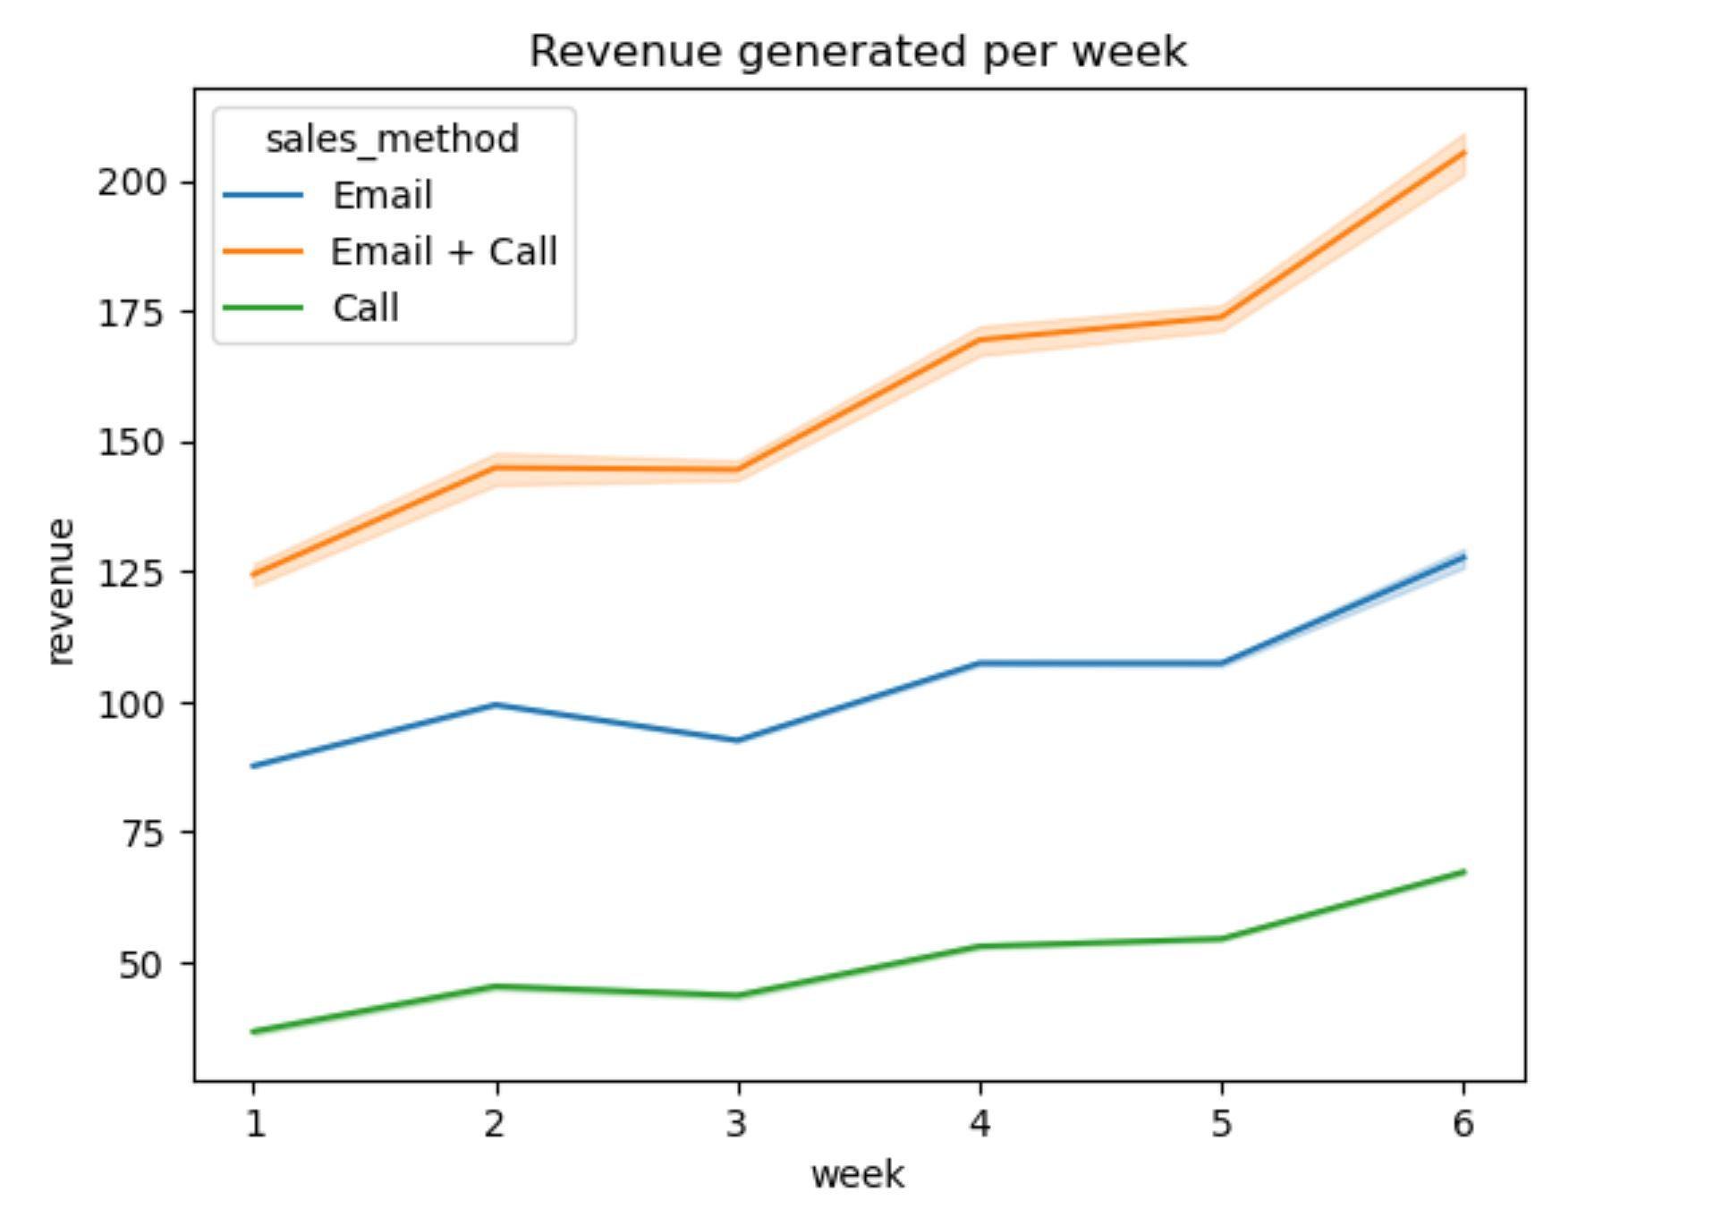
FINDINGS
Revenue generated over time
From the line plot, we can see upon release that the revenue generated from the Email + Call sales method has the highest revenue starting point and a highest growth rate over the six weeks compared to the other two sales methods.
Email + Call: 124 – 205
Email: 87.6 – 127.6
Call: 36.6 – 67.25

Slide 8
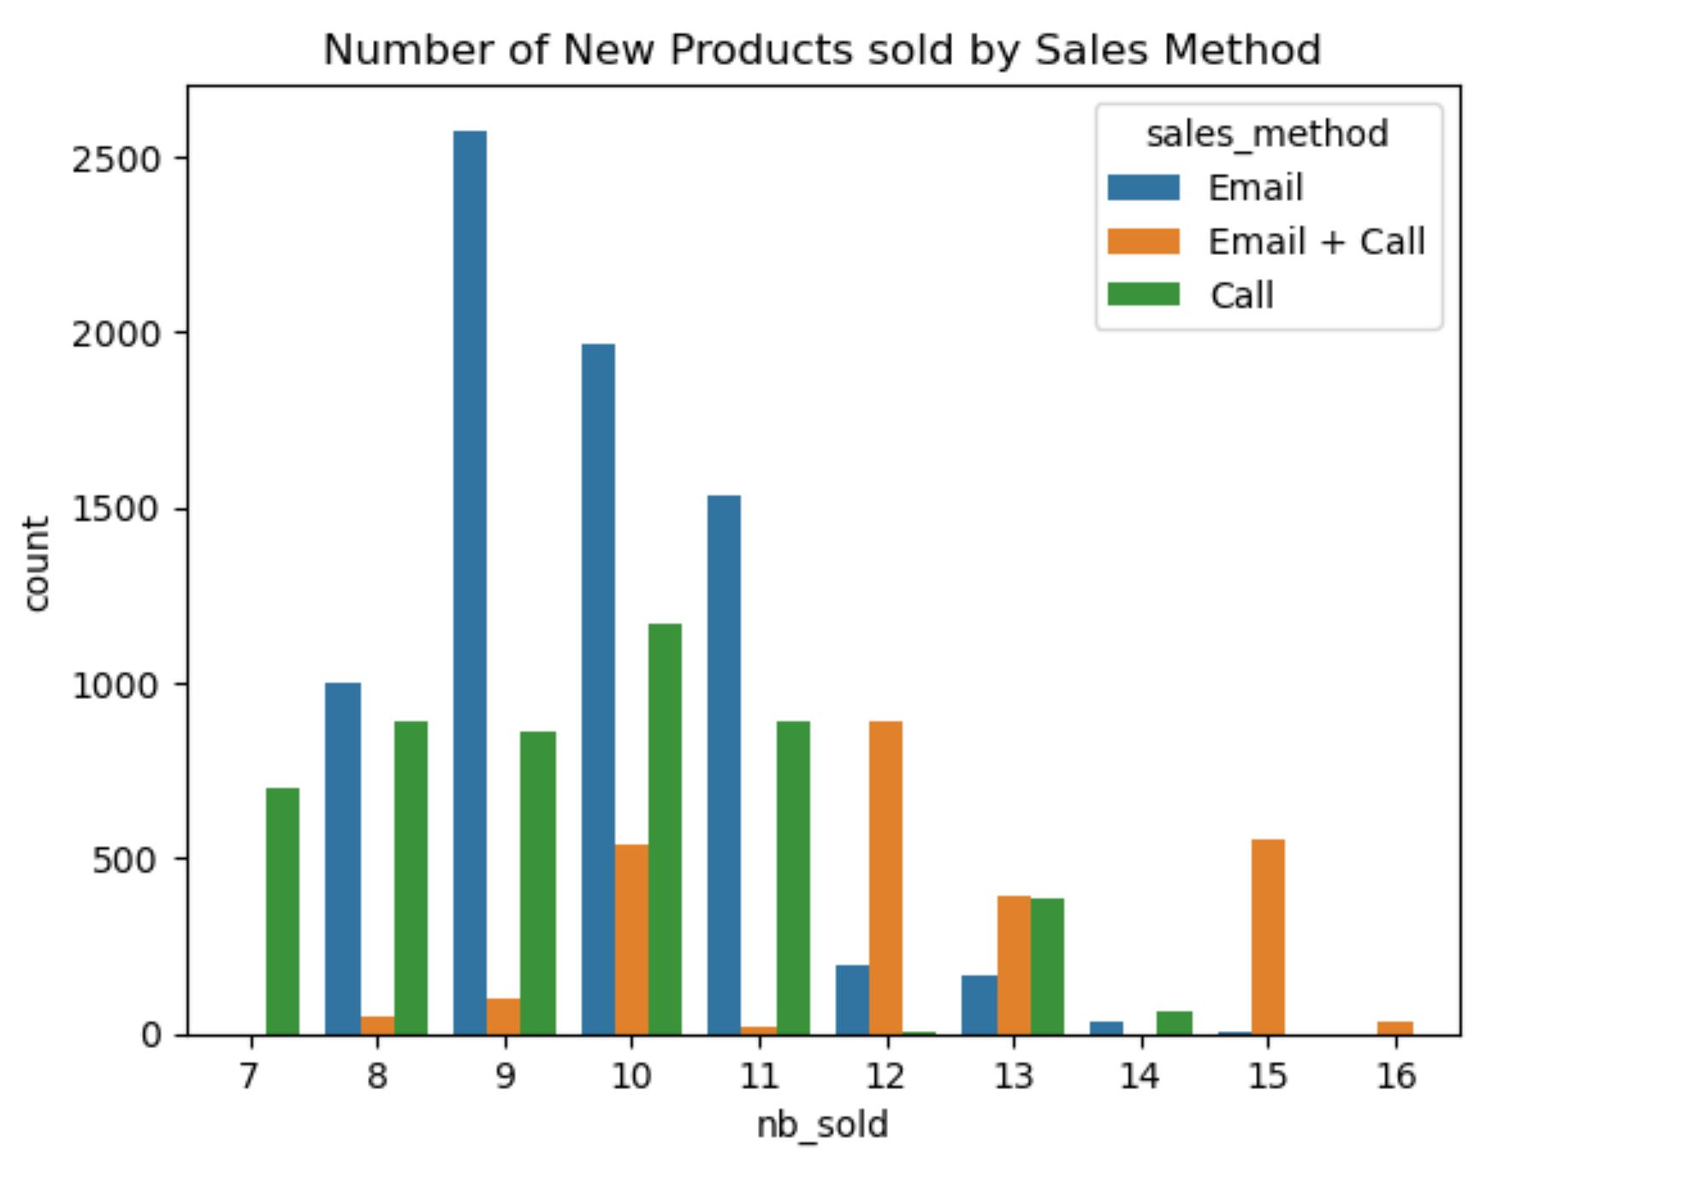
FINDINGS
Number of new products sold by sales method
Based on the data, customers that buy the products due to the Email + Call approach tend to buy a lot more products in one purchase than the other sales methods.
This can be an indication as to why the average revenue generated is the highest even though the number of customers contacted are the lowest.

Slide 9
BEST SALES METHOD FOR LAUNCH
Based on the findings in the data, the Email + Call sales method is the best approach we should focus on. The reasons being
It has the highest average revenue even with having the lowest number of customers by far
It has the highest growth rate within the first six weeks upon release of a new product.

Slide 10
BUSINESS METRICS
Since the goal is to increase both the revenue and identifying the most efficient sales method to focus on, I recommend we go with two metrics: percentage of number of customers to the total and the percentage of revenue to the total revenue with respect to the Email + Call approach. This will be done for the first 6 weeks of the new product launch.
Based on previous data, the Email + Call sales method had 17% of the total number of customers and 31% of the total revenue. Therefore if the numbers increase after six weeks of the new products launch, it indicates a good sign to achieving our goal.

Slide 11
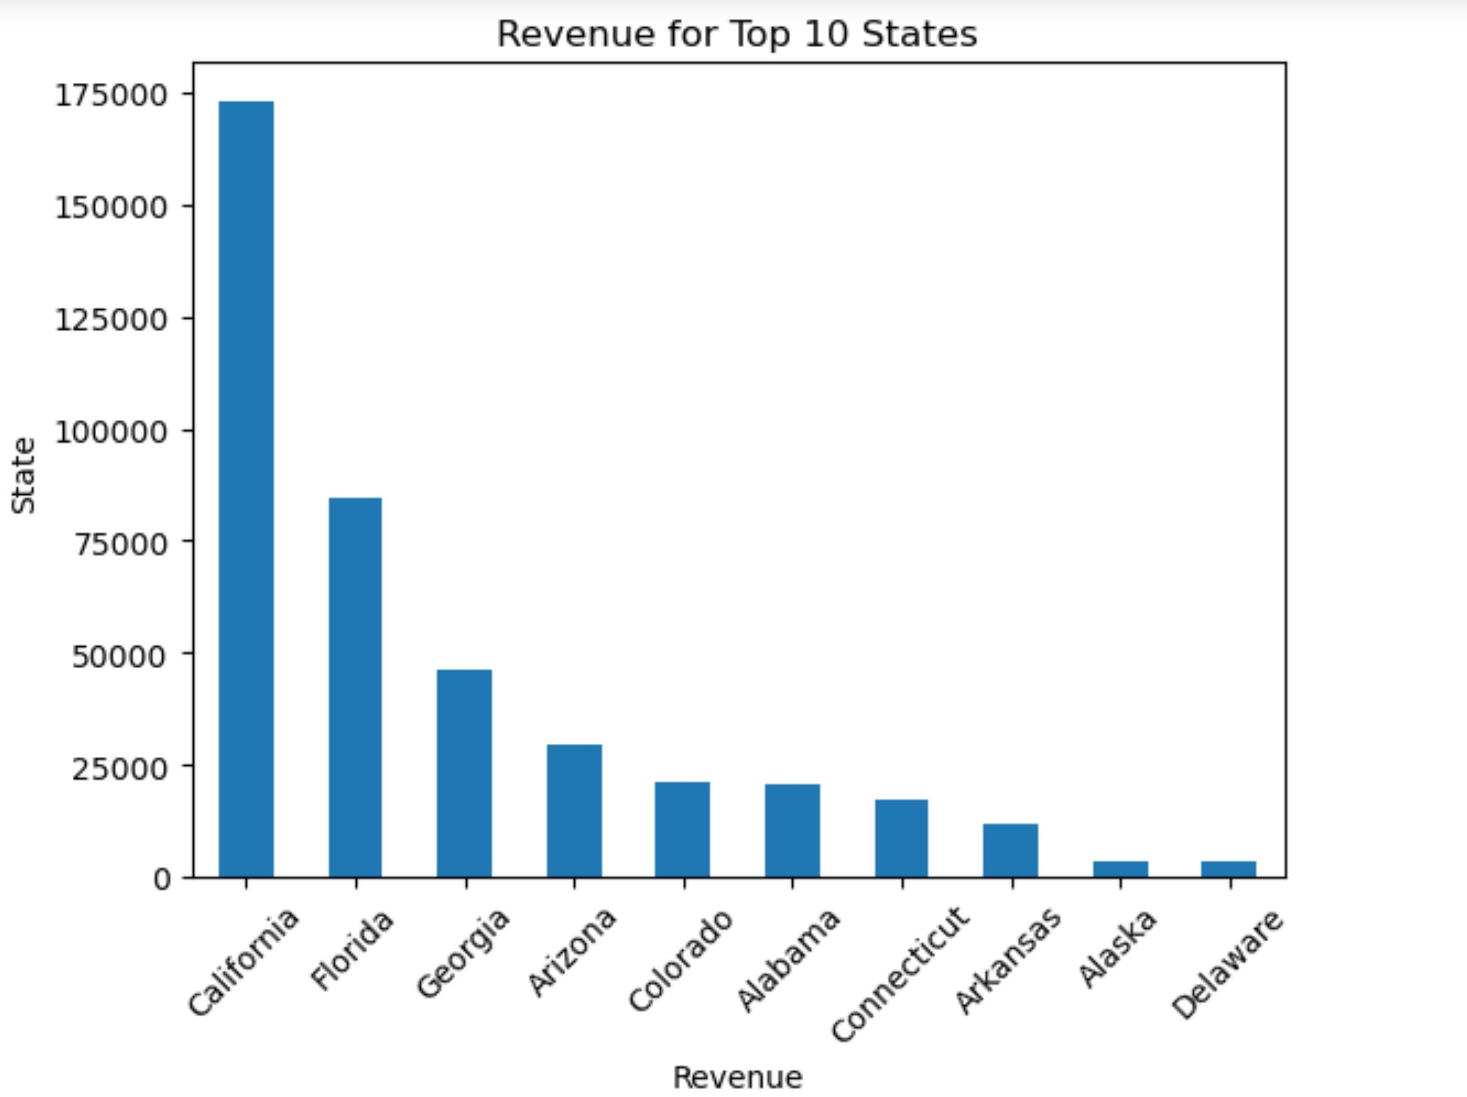
RECOMMENDATION
For the following weeks, my recommendation will be:
Increase the number of customers by using the Email + Call sales method.
If there’ll be a overload or a threat of efficiency, reduce the emphasis on the Call only method since it doesn’t bring as much revenue but it has a higher number of customers as compared to the Email + Call sales method.
Use the 2 key metrices to monitor whether there’s a strong sign for revenue growth even with a reduction of the other 2 sales methods.
A lot of focus should be on the top 10 states with respect to the Email + Call sales method.

